Slide 1
EHS <Course Number> <Course Title>
Instructor Name

Slide 2
Welcome
Facilitator: <Facilitator Name and Title>
Email: <facilitator email address>@lbl.gov
Website: <web address, if appropriate>.lbl.gov
Teaching Assistant: Kelly Palkki, EHS Administrative Assistant
Email: Training@lbl.gov
Phone: 1 (510) 495-2228
NOTE: Your TA and I will stay on this Zoom session for 10 minutes after the end of class for anyone who wants to ask questions or talk with us about anything related to teaching online. We’ll also take questions throughout this session.
Notes:
Say: Welcome everyone. I’m <your name>. I’m <your title> and I’ll be your facilitator for this session.
You know, this class used to be taught in-person. But because of our current Shelter-in-Place/Work-from-Home situation, we’ve had to transition this class to this online format. This format might be new to some of you so I will explain how each activity works as we get to it.
But first, let me introduce our Teaching Assistant, Frank Rosado. Frank will mute and unmute your audio for me. He’ll monitor the chat window for incoming questions, and he’ll also manage any technical issues that arise. If we’ve messed up some file permissions or you’re not able to access the appropriate Google Drive folders, Frank will work with you individually to resolve the issue to the best of his ability so that it doesn’t disrupt learning for everyone else in the class.
Both our contact information is here on-screen. You might want to take a moment to jot it down.
[Click] NOTE: Your TA and I will stay on this Zoom session for 10 minutes after the end of class for anyone who wants to ask questions or bend our ears about anything related to teaching online. We’ll also take questions throughout this session.

Slide 3
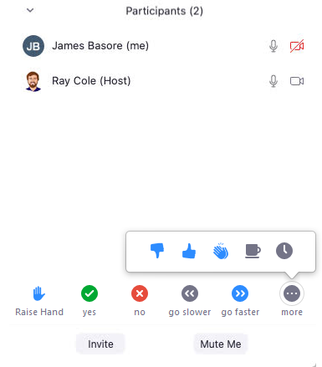
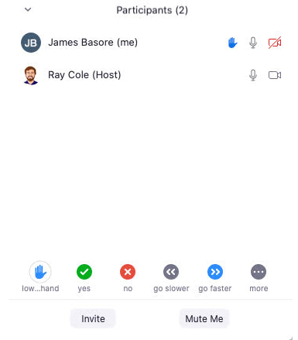
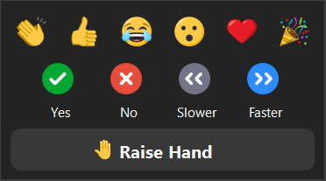
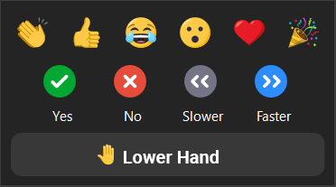
Using Zoom: Raising Your Hand
Click Participants to open the Participants panel
To raise your (virtual) hand, click Reactions
In the pop-up window, click Raise Hand
To verify, note hand symbol after your name
To lower your hand, click Reactions Again
Then click Lower Hand
To verify, note NO hand symbol after your name
Try it now: Everyone, raise your hand.
Try it now: Everyone, lower your hand.
2
(Click for older version)
Notes:
Say: Let’s start by making sure each of you is able to open the Participants window and raise your virtual hand. If you roll your mouse pointer to the bottom of your Zoom window, a Zoom control panel should reveal itself. [Click] Click Participants to open the Participants panel. With this panel up, you’ll be able to see your raised hand.
Next [click] , click the Reactions button. A menu of possible reactions pops up. At the bottom is [click] Raise Hand. After you click it, a [click] hand up icon appears next to your name in the Participants panel. Your hand stays up until you lower it.
To lower your hand, click [click] the Reactions button again. And then [click] click the Lower Hand button. When you do so, the hand-up icon disappears from after your name in the Participants panel.
[Click] Go head and try raising your hand now.
<Wait for everyone to click the Raise Your Hand button. As each person does, announce “I see <name of person> has raised her hand. Thank you. Also <name of another person> has raised his hand. Thanks. Etc. until all participants have successfully raised their hands.>
Say: OK. [Click] Now click the button to lower your (virtual) hands. Thanks.

Slide 4
Using Zoom: Raising Your Hand
Click Participants to open the Participants panel
To raise your (virtual) hand, click Raise Hand
To verify, note hand symbol after your name
To lower your hand, click Lower Hand
Try it now: Everyone, raise your hand.
Try it now: Everyone, lower your hand.
2
Notes:
Say: Let’s start by making sure each of you is able to open the Participants window and raise your virtual hand. If you roll your mouse pointer to the bottom of your Zoom window, a Zoom control panel should reveal itself. [Click] Click Participants to open the Participants panel. In the Participants panel, you’ll see some buttons. [Click] One of them is labeled Raise Hand. After you click it, a [click] hand up icon appears next to your name in the Participants panel and [click] a Lower Hand button appears where the Raise Hand button used to be. Click Lower Hand to lower your virtual hand. When you do so, the hand-up icon disappears from after your name in the Participants panel.
[Click] Go head and try raising your hand now.
<Wait for everyone to click the Raise Your Hand button. As each person does, announce “I see <name of person> has raised her hand. Thank you. Also <name of another person> has raised his hand. Thanks. Etc. until all participants have successfully raised their hands.>
Say: OK. [Click] Now click the button to lower your (virtual) hands. Thanks.

Slide 5
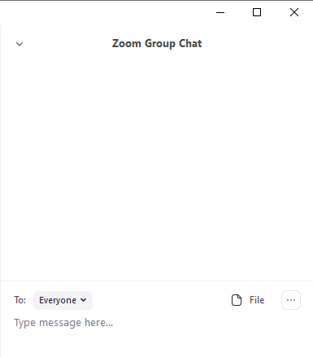
Using Zoom: Chat
Click Chat to open the Chat panel
Make sure your To: field is set appropriately
Type your message where it says Type message here…, then hit enter/return on your keyboard to send your chat message
Try it now: In the chat, tell me what city you’re in.
Notes:
Click through the points on the slide.

Slide 6
Using Zoom: Audio
If possible, use headphones or earbuds. This prevents feedback and echo when you speak.
You’ll enter the session Muted
Click Unmute on the Zoom control bar before speaking
Remember to Mute yourself when you are done
P
P
P
P
O
Notes:
Click through the points on the slide.
Last point:
Say: If at all possible, please join this session using “computer audio,” and not using your phone for the audio. If your internet connection is slow and you want to reduce the load this session places on it, it is OK to stop sending video. But try to keep the audio flowing through the computer instead of through a phone if you can. You may need to momentarily leave the meeting and rejoin to switch if you joined by dialing in for sound.

Slide 7
Log into Your Berkeley Lab Gmail Account
If you haven’t already done so, please log into your Berkeley Lab Gmail account now.
In order to access the resources I’m going to share with you, you need to be logged into your Berkeley Lab Google account. The easiest way to do that is to log into your Berkeley Lab Gmail.

Slide 8
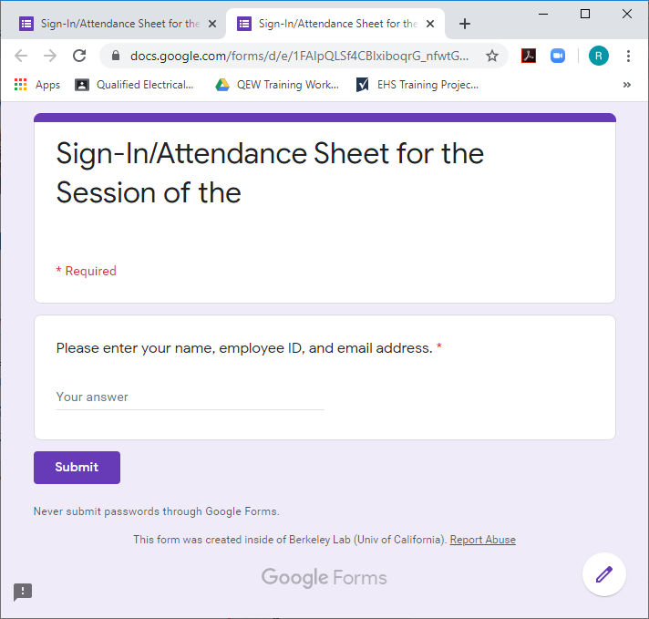
Attendance
Check your Chat panel for the link to the attendance sheet.
Sign-In/Attendance Sheet for the 5/22/20 Session of the Remote Teaching Toolkit Class
Notes:
Say: Check your chat window now for the link to the sign-in sheet for this class. To get credit for this class, you need to “sign in” by entering your name, employee ID, and email address.

Slide 9
Course Agenda
Welcome
Skill or Topic 1
Skill or Topic 2
Skill or Topic 3
…Etc….
Q&A, Wrap-Up
Notes:
Say: Here’s our agenda for the hour.
You’re required to take this course if you are a member of any Work Planning and Control (WPC) activity in which you will be <whatever triggers this course as a requirement>.
<Etc. Go over your agenda for the session.>

